Slide 1


BDM Project
PRESENTATION
Optimising the purchasing system of a small shop
By Anirudh Gautham (21f2000384)

Slide 2

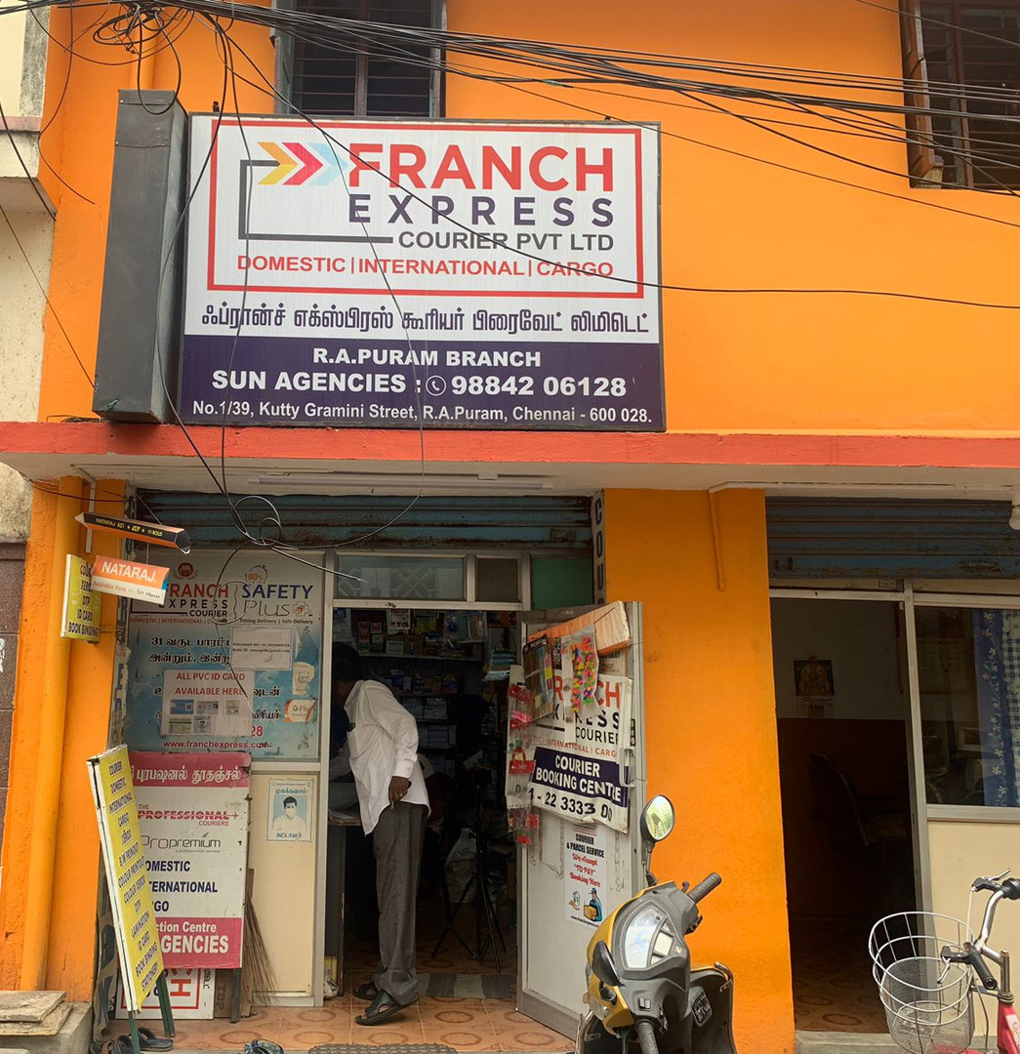
SUN
AGENCIES
A small shop in RA Puram, Chennai
Sells stationary, snacks and other daily items
Owned and run by Mr. Murugesh, a longtime entrepreneur

Slide 3
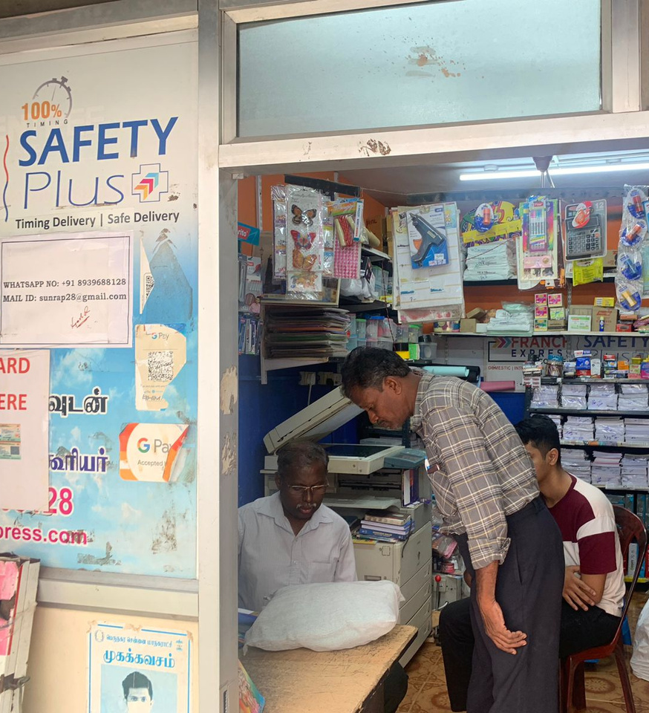
CHALLENGES FACED
Allocation of money among products and categories.
Selection of products to sell.
No coordinated purchasing system.
Lack of useful data

Slide 4
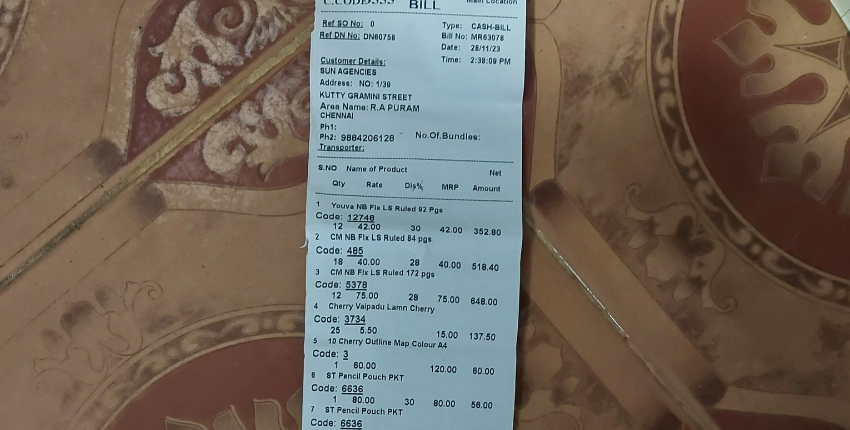
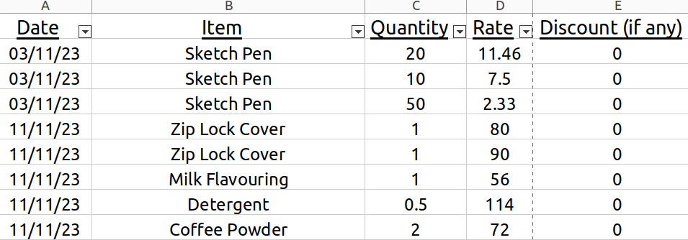
OVERVIEW OF DATA COLLECTED
Purchases data for November 2023 - February 2024 (plus 3 days of March) collected for analysis.
Data sourced from bills then entered into Excel sheet.
All purchases are divided into 6 categories: Stationary, Snacks, Entertainment, Household Item, Cooking Ingredients

Slide 5
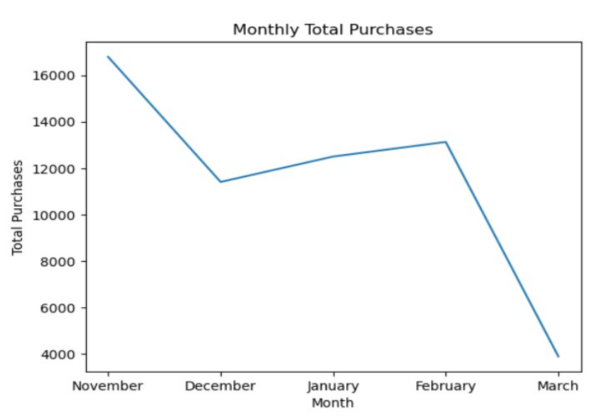
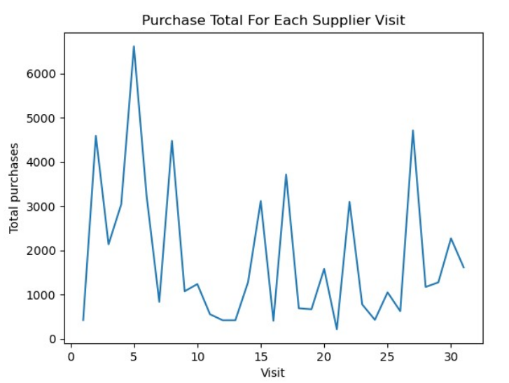
GENERAL ANALYSIS OF DATA
Total purchases for the period is ₹57,716
Peaked in November and lowest in December due to Chennai floods
Average purchase value is ₹198
Average quantity purchased is 9 units
31 visits made to suppliers - one every 4 days

Slide 6
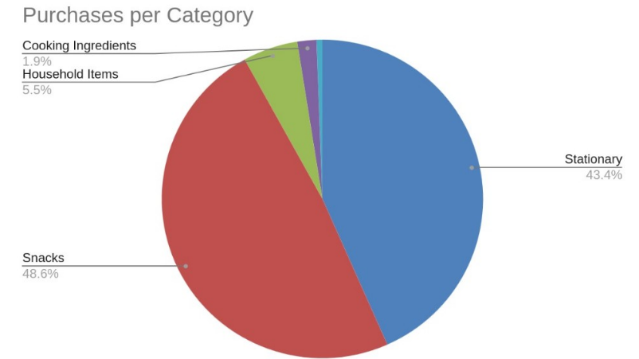
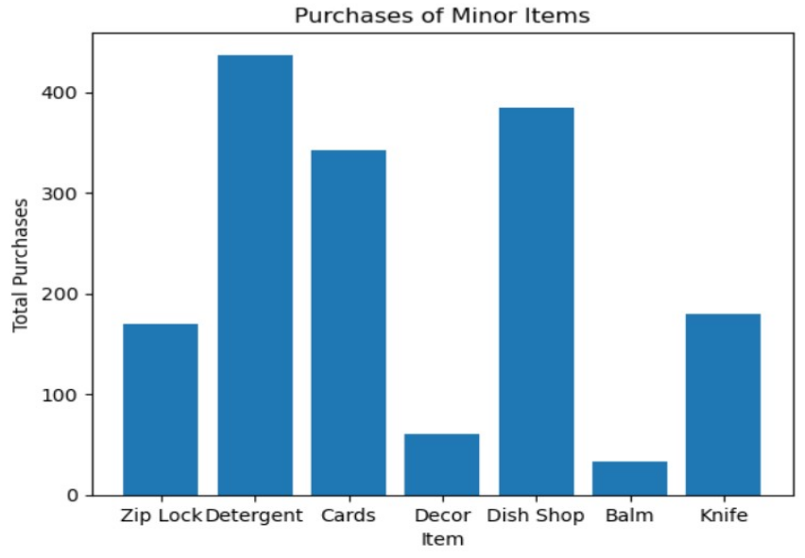
CATEGORY ANALYSIS
93% of all purchases are made on snacks and stationary.
Stationary - low price, high quantity
Snacks - high price, low quantity
Varying trends - stationary peaks in November, snacks in February
7% spent on ‘minor’ categories is insignificant and scattered across products.

Slide 7
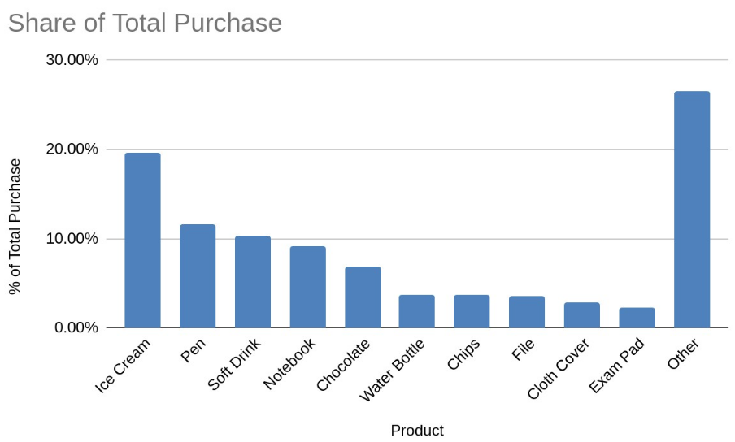
PRODUCT ANALYSIS
Top 10 most purchased items account for 74% of total purchases, resembling a Pareto distribution
However, frequency of purchases doesn’t mirror total expenditure - some items are bought frequently and in low amounts, and vice versa
Prices of snack items tend to be volatile - high standard deviation, as opposed to stationary products.

Slide 8
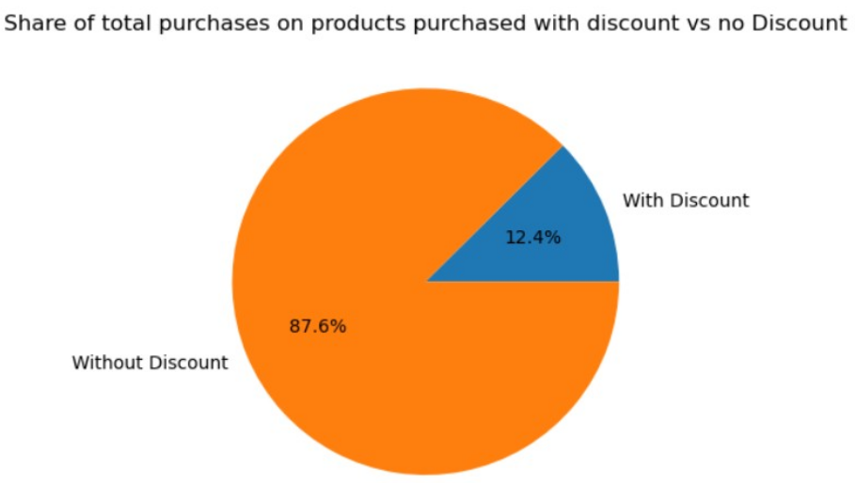
DISCOUNT ANALYSIS
Discounts availed on only 12.5% of total purchases - a huge opportunity
As mentioned, average purchase quantity is very low - 9 units
Purchases are also made very frequently - every 4 days
However, not much wiggle room since snacks products are often perishable

Slide 9
RECOMMENDATIONS FOR THE BUSINESS
Narrower product line - too many goods being dealt without coordination with each other. Best to focus on the top stationary and snacks products
Bulk purchasing - beyond saving time, will also help obtain discounts, obtain better prices and reduce delivery costs
Negotiate better discounts - through bulk purchasing and building sustained relationships with selected suppliers
Seasonal Planning - fluctuations seen based on month and season, planning in advance will make purchases more predictable and obtain better prices
Coordinated, structured purchasing system
Collection and maintenance of data - essential to maintain a record of all business activity, to help analyse performance and help students!

Slide 10
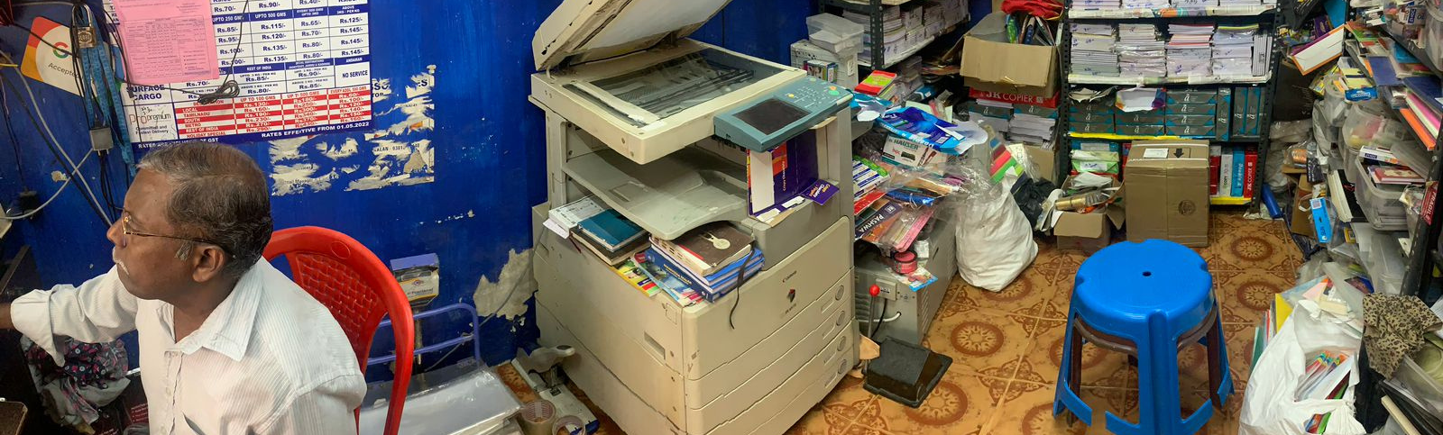
THANK YOU!
Data, shop pics and interview - https://drive.google.com/drive/folders/1HRDoGGvL8bSmpGFkU4H0Sm1RMjHhSHFv?usp=drive_link

